Slide 1
Hello.

Slide 2


The Course
Session 1
Grounding -
What is marketing
The Course
Understanding Critical Concepts in marketing
Session 2
Critical Concepts
Needs, wants, Demands
Consumer vs Customer
Marketing Environment
Session 3
Consumer Behavior
Neuroscience
Consumer Buying Behavior – Consumer Bias
Consumer Funnels
Knowing Consumers Better
Session 4
Target Consumer
Segmenting & Targeting
Pen Profiles
Understanding Motivations
Session 5
Customer value
Types of Benefits
Differentiation
Positioning

Slide 3


Think of new brand/Product you bought!
When/How did you hear about it?
What did you do to know more? ( if you did that is)
Why did you buy it? What made you buy it
Did you buy more? Stop buying?
Did you recommend to Anyone
Did you speak to Brand

Slide 4




Managing Customer Relationships
Driving funnel
Make them aware
Attract/Get them to know about your offering
Drive preference
Build relevance and liking
Convert
Get them to buy/Click to buy/Line up
Engage
Top of mind for offering
Retain
Loyalty/Buy again/More/Cross sell/Redressals
Notes:
A customer relationship develops progressively. At each stage, the customer has a different question in their mind, and therefore marketing has a different job to do. Good marketing recognizes where the customer is in the funnel and uses the right intervention for that stage.
The funnel gets narrower because a much larger number of people will know about a brand than will eventually buy it. If 10 million people are aware of a brand, perhaps 3 million seriously consider it, 1 million try it, and a smaller number become repeat customers. One of marketing's jobs is therefore to reduce leakage as consumers move down the funnel.
1. Make Them Aware — “Do I know you?”
The first task of marketing is simply to enter the consumer's mental universe.
A consumer cannot consider or buy a brand that they do not know exists. Awareness is therefore about creating mental availability — ensuring that the brand comes to mind when the relevant category or need arises.
For example, if someone thinks, “I need food delivered tonight,” which brands immediately come to mind? If Zomato and Swiggy are the first two names recalled, both brands have achieved strong mental availability.
Awareness can come through advertising, social media, influencers, PR, sponsorships, word of mouth, retail visibility, packaging, search, etc.
There are different strengths of awareness:
Recognition: “I've heard of this brand.”
Recall: “I can remember this brand without being prompted.”
Top-of-mind: “This is the first brand I think of.”
The marketer's challenge is not simply to create maximum awareness. It is to create awareness among the right audience and in the right buying context.
Useful classroom question:
“If I say online food delivery, which brand comes to mind first? If I say toothpaste? Luxury smartphone? Why?”
This demonstrates that brands compete for a place in memory long before they compete at the point of purchase.
. Drive Preference — “Why should I choose you?”
Awareness gets you into the consideration set. It does not automatically get you chosen.
Once consumers know a brand, marketing has to create relevance and preference.
The consumer is effectively asking:
“There are five brands I could buy. Why this one?”
This is where positioning, differentiation and brand meaning become important.
Preference can be created through different kinds of value:
Functional superiority — performs better.
Emotional relevance — makes me feel a certain way.
Identity — says something about who I am.
Convenience — easier to access or use.
Trust — feels safer or more reliable.
Price/value — gives me more for my money.
For example, two consumers may both be aware of Apple and Samsung. Preference is about why one eventually says, “Apple is for me.”
A useful distinction for students is:
Awareness = I know you.
Preference = I want you.
Marketing communication therefore cannot stop at visibility. It has to give the consumer a reason to choose.
3. Convert — “Why should I buy now?”
A consumer can like a brand enormously and still never buy it.
Conversion is about turning intent into action.
At this stage the question changes from “Do I like this brand?” to:
“Am I willing to part with my money now?”
Many barriers can prevent conversion:
Price is too high.
Product isn't available.
Buying process is difficult.
Consumer needs more reassurance.
Another brand offers a better deal.
Consumer postpones the decision.
This is why marketing and sales intersect strongly at the conversion stage.
Typical conversion tools include promotions, trials, demonstrations, reviews, testimonials, free shipping, retail visibility, calls to action, easy checkout, financing, discounts and sales assistance.
For digital businesses, this stage is particularly measurable:
Ad → Landing page → Product page → Add to cart → Checkout → Purchase.
Every additional friction can reduce conversion.
A useful principle to teach here:
Brand building creates desire; activation removes barriers to acting on that desire.
Both are necessary.
4. Engage — “Will you remain relevant to me?”
Marketing does not end when somebody buys.
This is one of the major shifts from traditional transactional marketing toward relationship marketing.
After a purchase, brands need to remain relevant so that the relationship does not disappear between transactions.
Engagement may involve content, notifications, communities, useful information, service communication, product education, rewards or new experiences.
Consider Spotify. The relationship is not simply:
Subscribe → transaction over.
Discover Weekly, Wrapped, personalized playlists and recommendations continually give users reasons to interact with Spotify.
The goal is to create ongoing salience and value between purchases.
But there is an important warning for students:
Engagement is not the same as bombarding customers with communication.
Ten irrelevant WhatsApp messages do not create a stronger relationship. They may actually damage it.
Good engagement creates value for the customer rather than simply creating activity for the marketer.
5. Retain — “Why should I continue choosing you?”
Retention is where the economic value of customer relationships becomes particularly important.
Acquiring a customer once is useful. Getting that customer to return repeatedly can be far more valuable.
Retention can take several forms:
Repeat: Buy the same product again.
More: Increase frequency or quantity.
Cross-sell: Buy another product from the brand.
Upsell: Move to a higher-value offering.
Advocacy: Recommend the brand to others.
Redressal: Resolve problems well enough to preserve the relationship.
Consider Amazon. The initial objective may be to get someone to make one purchase. But the larger business opportunity is to make Amazon the customer's default shopping behaviour.
Similarly, a bank does not simply want someone to open an account. Over time it might want the customer to use cards, deposits, loans, investments and insurance.
This introduces the idea of Customer Lifetime Value (CLV):
The economic value of a customer is not merely what they buy today, but what they may buy throughout their relationship with the business.
An important nuance about the funnel
Although we draw it as a neat funnel, real consumer journeys are rarely this linear.
Consumers can:
Aware → Consider → Forget → Rediscover → Search → Compare → Buy → Stop → Return.
They may see an Instagram post, ask a friend, search Google, visit a store, check Amazon reviews, leave without purchasing and finally buy three weeks later.
So the funnel should be understood as a managerial framework, not a literal description of how every customer behaves.
Increasingly, the bottom of the funnel can also feed the top.

Slide 5
A customer relationship develops progressively. At each stage, the customer has a different question in their mind, and therefore marketing has a different job to do. Good marketing recognizes where the customer is in the funnel and uses the right intervention for that stage.
The funnel gets narrower because a much larger number of people will know about a brand than will eventually buy it. If 10 million people are aware of a brand, perhaps 3 million seriously consider it, 1 million try it, and a smaller number become repeat customers. One of marketing's jobs is therefore to reduce leakage as consumers move down the funnel.
1. Make Them Aware — “Do I know you?”
The first task of marketing is simply to enter the consumer's mental universe.
A consumer cannot consider or buy a brand that they do not know exists. Awareness is therefore about creating mental availability — ensuring that the brand comes to mind when the relevant category or need arises.
For example, if someone thinks, “I need food delivered tonight,” which brands immediately come to mind? If Zomato and Swiggy are the first two names recalled, both brands have achieved strong mental availability.
Awareness can come through advertising, social media, influencers, PR, sponsorships, word of mouth, retail visibility, packaging, search, etc.
There are different strengths of awareness:
Recognition: “I've heard of this brand.”
Recall: “I can remember this brand without being prompted.”
Top-of-mind: “This is the first brand I think of.”
The marketer's challenge is not simply to create maximum awareness. It is to create awareness among the right audience and in the right buying context.
Useful classroom question:
“If I say online food delivery, which brand comes to mind first? If I say toothpaste? Luxury smartphone? Why?”
This demonstrates that brands compete for a place in memory long before they compete at the point of purchase.

Slide 6
. Drive Preference — “Why should I choose you?”
Awareness gets you into the consideration set. It does not automatically get you chosen.
Once consumers know a brand, marketing has to create relevance and preference.
The consumer is effectively asking:
“There are five brands I could buy. Why this one?”
This is where positioning, differentiation and brand meaning become important.
Preference can be created through different kinds of value:
Functional superiority — performs better.
Emotional relevance — makes me feel a certain way.
Identity — says something about who I am.
Convenience — easier to access or use.
Trust — feels safer or more reliable.
Price/value — gives me more for my money.
For example, two consumers may both be aware of Apple and Samsung. Preference is about why one eventually says, “Apple is for me.”
A useful distinction for students is:
Awareness = I know you.
Preference = I want you.
Marketing communication therefore cannot stop at visibility. It has to give the consumer a reason to choose.

Slide 7
3. Convert — “Why should I buy now?”
A consumer can like a brand enormously and still never buy it.
Conversion is about turning intent into action.
At this stage the question changes from “Do I like this brand?” to:
“Am I willing to part with my money now?”
Many barriers can prevent conversion:
Price is too high.
Product isn't available.
Buying process is difficult.
Consumer needs more reassurance.
Another brand offers a better deal.
Consumer postpones the decision.
This is why marketing and sales intersect strongly at the conversion stage.
Typical conversion tools include promotions, trials, demonstrations, reviews, testimonials, free shipping, retail visibility, calls to action, easy checkout, financing, discounts and sales assistance.
For digital businesses, this stage is particularly measurable:
Ad → Landing page → Product page → Add to cart → Checkout → Purchase.
Every additional friction can reduce conversion.
A useful principle to teach here:
Brand building creates desire; activation removes barriers to acting on that desire.
Both are necessary.
4. Engage — “Will you remain relevant to me?”
Marketing does not end when somebody buys.
This is one of the major shifts from traditional transactional marketing toward relationship marketing.
After a purchase, brands need to remain relevant so that the relationship does not disappear between transactions.
Engagement may involve content, notifications, communities, useful information, service communication, product education, rewards or new experiences.
Consider Spotify. The relationship is not simply:
Subscribe → transaction over.
Discover Weekly, Wrapped, personalized playlists and recommendations continually give users reasons to interact with Spotify.
The goal is to create ongoing salience and value between purchases.
But there is an important warning for students:
Engagement is not the same as bombarding customers with communication.
Ten irrelevant WhatsApp messages do not create a stronger relationship. They may actually damage it.
Good engagement creates value for the customer rather than simply creating activity for the marketer.

Slide 8
5. Retain — “Why should I continue choosing you?”
Retention is where the economic value of customer relationships becomes particularly important.
Acquiring a customer once is useful. Getting that customer to return repeatedly can be far more valuable.
Retention can take several forms:
Repeat: Buy the same product again.
More: Increase frequency or quantity.
Cross-sell: Buy another product from the brand.
Upsell: Move to a higher-value offering.
Advocacy: Recommend the brand to others.
Redressal: Resolve problems well enough to preserve the relationship.
Consider Amazon. The initial objective may be to get someone to make one purchase. But the larger business opportunity is to make Amazon the customer's default shopping behaviour.
Similarly, a bank does not simply want someone to open an account. Over time it might want the customer to use cards, deposits, loans, investments and insurance.
This introduces the idea of Customer Lifetime Value (CLV):
The economic value of a customer is not merely what they buy today, but what they may buy throughout their relationship with the business.
An important nuance about the funnel
Although we draw it as a neat funnel, real consumer journeys are rarely this linear.
Consumers can:
Aware → Consider → Forget → Rediscover → Search → Compare → Buy → Stop → Return.
They may see an Instagram post, ask a friend, search Google, visit a store, check Amazon reviews, leave without purchasing and finally buy three weeks later.
So the funnel should be understood as a managerial framework, not a literal description of how every customer behaves.
Increasingly, the bottom of the funnel can also feed the top.

Slide 9
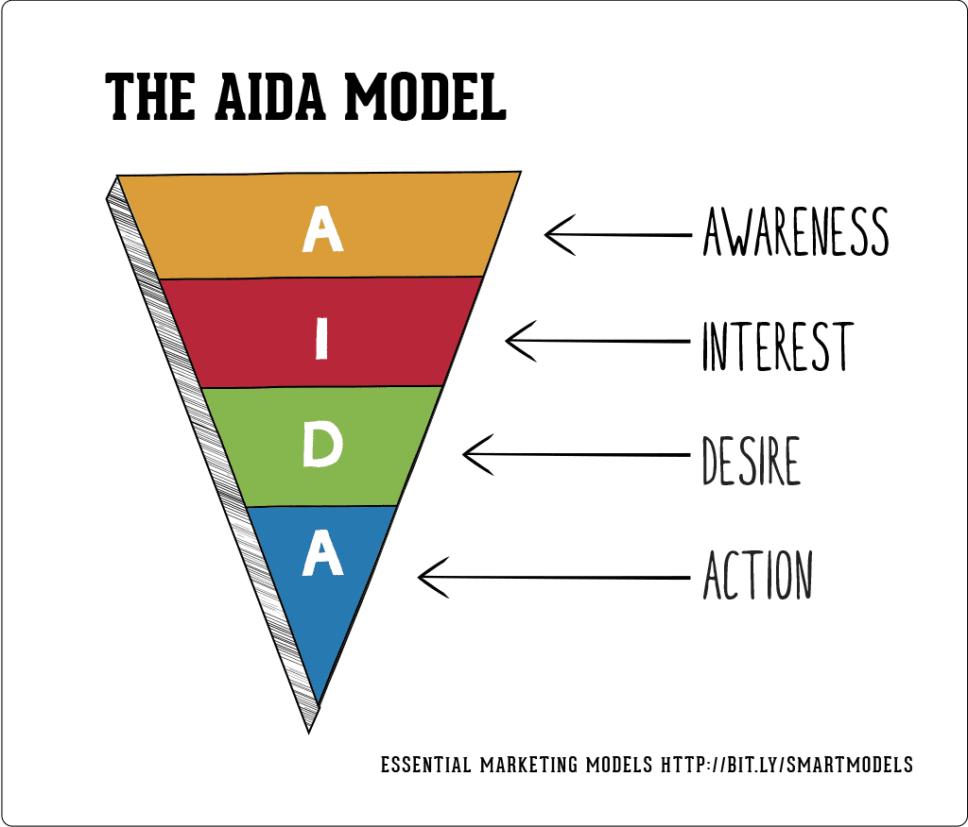
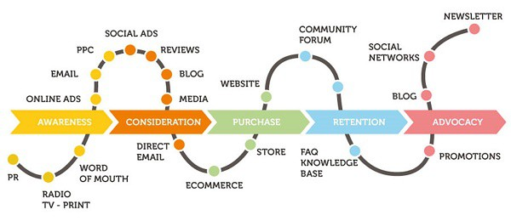
How consumers end up buying
Notes:
Please go through this link for detailed understanding of AIDA model
https://www.youtube.com/watch?v=st0aJ-Vpln8

Slide 10
Please go through this link for detailed understanding of AIDA model
https://www.youtube.com/watch?v=st0aJ-Vpln8

Slide 11

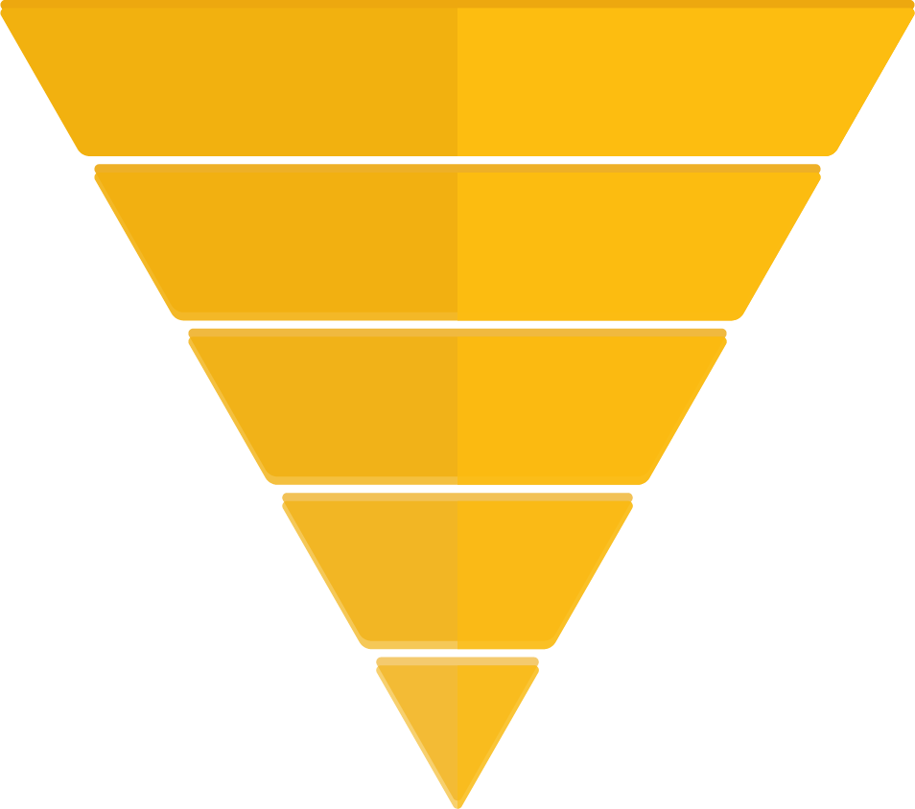
Consumers Progress through Funnels!
Brand
USAGE
Digital Funnel
Make them Aware
Aware
Visited Website
Drive Preference
Ever Tried
ATC
Convert
Buy Once a month
Bought Once
Engage
Buy Weekly
Repeat
Retain
MOUB
Loyal
ATC – Added to Cart
MOUB – Most often used Brand

Slide 12
Consumers Progress through Funnels – Epigamia Usage funnels
USAGE
Aware
3.6 cr.
Ever Tried
1.8 cr.
Buy Once a month
0.7 cr.
Buy Weekly
0.10 cr.
MOUB
0.09 cr.

Slide 13
Understanding stages of buying Decision Process
Sharing
Wanting More/Post Purchase
Reflecting & Repurchasing
Using
Evaluation & Purchase
Choosing & Coordinating
Learning
Witnessing
Arriving & Browsing
Information Search
Researching
Inspired
Witnessing
Wanting/Problem Recognition
Notes:
Notes
1. Wanting / Problem Recognition
The buying journey begins when a consumer feels a gap between their current state and what they desire. This isn’t always about necessity — it’s often about aspiration, self-expression, or lifestyle. Brands create this spark by highlighting problems or showing possibilities.
Examples: Apple creates anticipation for new iPhones even when older models still work; Nykaa’s beauty campaigns show new looks that trigger a sense of wanting; Swiggy’s “midnight cravings” ads transform boredom into food orders.
2. Information Search
Once the want is triggered, consumers actively look for ways to satisfy it. They search online, read reviews, check social media, and ask friends. At this stage, visibility and credibility are key for brands.
Examples: Zomato and Swiggy dominate search results for “restaurants near me”; Amazon’s product reviews and star ratings guide purchase choices; Mamaearth leverages influencer tutorials to appear in everyday content feeds.
3. Evaluation
Consumers then compare different options, weighing features, benefits, and overall value. While the process seems rational, brand storytelling, positioning, and relevance to the consumer’s lifestyle are often what tip the balance.
Examples: Netflix frames its subscription tiers in terms of quality and sharing; Starbucks positions its drinks as lifestyle experiences rather than just beverages; Nike emphasizes identity and empowerment alongside product performance.
4. Purchase
The decision turns into action when the consumer makes the transaction. Brands focus on making this moment simple, fast, and satisfying. Promotions, limited-time offers, and seamless checkout experiences help remove barriers and push the decision over the line.
Examples: Amazon’s “Buy Now with 1-Click” removes checkout friction; Flipkart’s “Big Billion Day” creates urgency with time-bound deals; Uber makes booking easy with a few taps on the app.
5. Wanting More / Post-Purchase Behaviour
The journey doesn’t end at the purchase. How consumers feel afterwards determines loyalty, advocacy, and the desire for more. Successful brands create ecosystems, rituals, and communities that encourage repeat engagement and deeper connection.
Examples: Apple builds ongoing desire through its ecosystem (buy an iPhone, then AirPods, then a Watch); Starbucks uses its loyalty app to keep customers returning; Sephora’s Beauty Insider program rewards customers and builds a sense of community.

Slide 14
Notes
1. Wanting / Problem Recognition
The buying journey begins when a consumer feels a gap between their current state and what they desire. This isn’t always about necessity — it’s often about aspiration, self-expression, or lifestyle. Brands create this spark by highlighting problems or showing possibilities.
Examples: Apple creates anticipation for new iPhones even when older models still work; Nykaa’s beauty campaigns show new looks that trigger a sense of wanting; Swiggy’s “midnight cravings” ads transform boredom into food orders.
2. Information Search
Once the want is triggered, consumers actively look for ways to satisfy it. They search online, read reviews, check social media, and ask friends. At this stage, visibility and credibility are key for brands.
Examples: Zomato and Swiggy dominate search results for “restaurants near me”; Amazon’s product reviews and star ratings guide purchase choices; Mamaearth leverages influencer tutorials to appear in everyday content feeds.
3. Evaluation
Consumers then compare different options, weighing features, benefits, and overall value. While the process seems rational, brand storytelling, positioning, and relevance to the consumer’s lifestyle are often what tip the balance.
Examples: Netflix frames its subscription tiers in terms of quality and sharing; Starbucks positions its drinks as lifestyle experiences rather than just beverages; Nike emphasizes identity and empowerment alongside product performance.
4. Purchase
The decision turns into action when the consumer makes the transaction. Brands focus on making this moment simple, fast, and satisfying. Promotions, limited-time offers, and seamless checkout experiences help remove barriers and push the decision over the line.
Examples: Amazon’s “Buy Now with 1-Click” removes checkout friction; Flipkart’s “Big Billion Day” creates urgency with time-bound deals; Uber makes booking easy with a few taps on the app.
5. Wanting More / Post-Purchase Behaviour
The journey doesn’t end at the purchase. How consumers feel afterwards determines loyalty, advocacy, and the desire for more. Successful brands create ecosystems, rituals, and communities that encourage repeat engagement and deeper connection.
Examples: Apple builds ongoing desire through its ecosystem (buy an iPhone, then AirPods, then a Watch); Starbucks uses its loyalty app to keep customers returning; Sephora’s Beauty Insider program rewards customers and builds a sense of community.

Slide 15



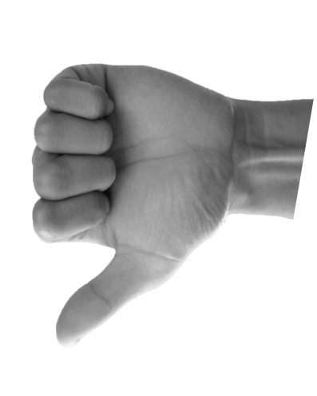
Poll – Agree or Don’t Agree?
“Human beings are rational and purely make decisions based on price, value and features”
Notes:
Must Reads (Make sure you add this to the list of book you read before you finish this year)
Alchemy by Rory Sutherland
Buyology – Martin Lindstrom
Recommended Read- Behave by Robert Sapolovsky ( This is tough read, but go ahead take up the challenge and you wont regret it)

Slide 16
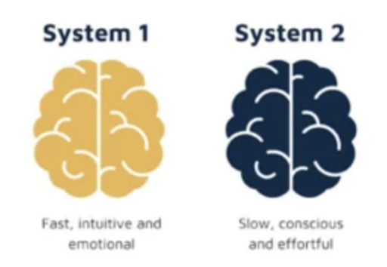
Our brain is a survival engine
Notes:
Recommended Reads
Think Fast and Think Slow by Daniel Kahneman & Amor Tversky
Seven and half Lessons about the Brain by Lisa Feldman
Notes for Slide
Our brain is a survival engine. It's fast, efficient—and constantly cutting corners.
Psychologists often describe it as having two systems:
System 1 is fast, intuitive, emotional.
System 2 is slow, rational, and deliberate.
Now here’s the thing: System 1 is running the show most of the time.
We think we’re making decisions like a spreadsheet, but really—we’re responding like a reflex. The brand of soap you use, the breakfast cereal you grab, the coffee shop you walk into… these aren't all thoughtful choices. They’re habits. Shortcuts. Heuristics.
And brands that win? They don't fight this—they work with it.
They use colors that trigger memory. They build rituals that stick. They attach to emotions that bypass logic.
Even your brain chemistry plays along.
Dopamine gives us a hit when we anticipate a reward—why unboxing videos and flash sales are so addictive.
Oxytocin fuels trust—why stories, warmth, and brand purpose connect deeper than product features.
Cortisol gets triggered by fear and urgency—think insurance ads or countdown timers.
In short, the mind isn’t a neutral place. It’s emotional. It’s social. It’s meaning-hungry.

Slide 17
Recommended Reads
Think Fast and Think Slow by Daniel Kahneman & Amor Tversky
Seven and half Lessons about the Brain by Lisa Feldman
Notes for Slide
Our brain is a survival engine. It's fast, efficient—and constantly cutting corners.
Psychologists often describe it as having two systems:
System 1 is fast, intuitive, emotional.
System 2 is slow, rational, and deliberate.
Now here’s the thing: System 1 is running the show most of the time.
We think we’re making decisions like a spreadsheet, but really—we’re responding like a reflex. The brand of soap you use, the breakfast cereal you grab, the coffee shop you walk into… these aren't all thoughtful choices. They’re habits. Shortcuts. Heuristics.
And brands that win? They don't fight this—they work with it.
They use colors that trigger memory. They build rituals that stick. They attach to emotions that bypass logic.
Even your brain chemistry plays along.
Dopamine gives us a hit when we anticipate a reward—why unboxing videos and flash sales are so addictive.
Oxytocin fuels trust—why stories, warmth, and brand purpose connect deeper than product features.
Cortisol gets triggered by fear and urgency—think insurance ads or countdown timers.
In short, the mind isn’t a neutral place. It’s emotional. It’s social. It’s meaning-hungry.

Slide 18
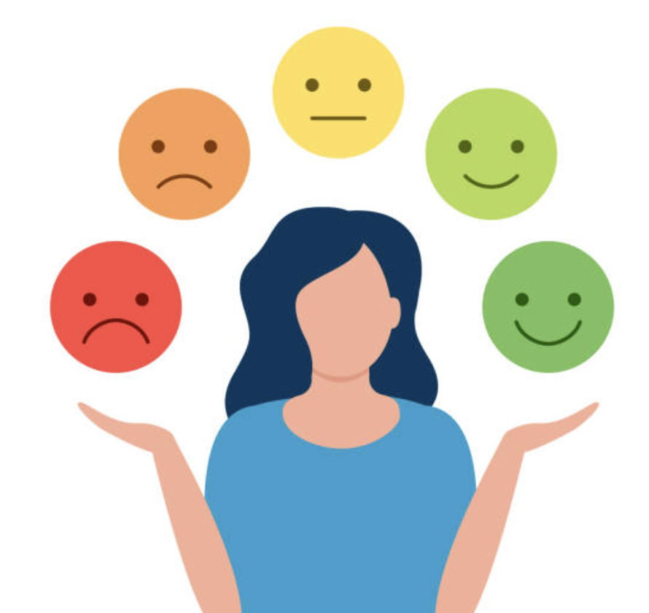


Consumers don’t just rely on Logic, but take shortcuts
Notes:
Our brains are meaning-making machines. We don’t just consume products. We consume stories. Symbols. Signals.

Slide 19
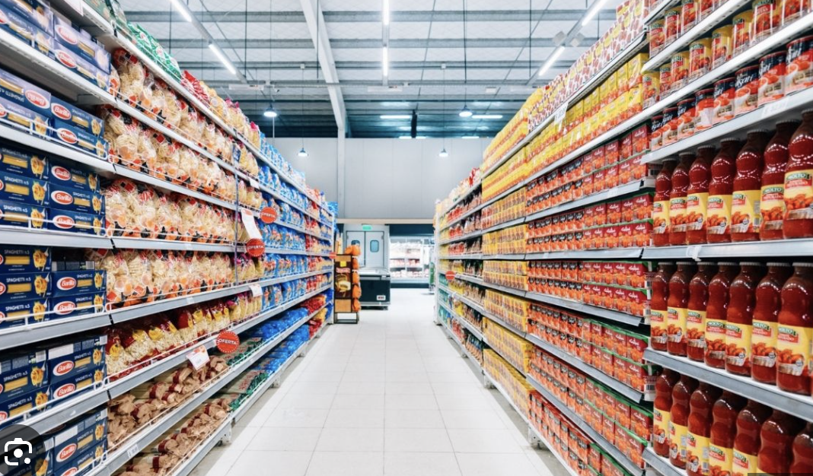
Always looking to reduce cognitive load

Slide 20
Consumers don’t just rely on Logic, but take shortcuts
Notes:
Our brains are meaning-making machines. We don’t just consume products. We consume stories. Symbols. Signals.

Slide 21
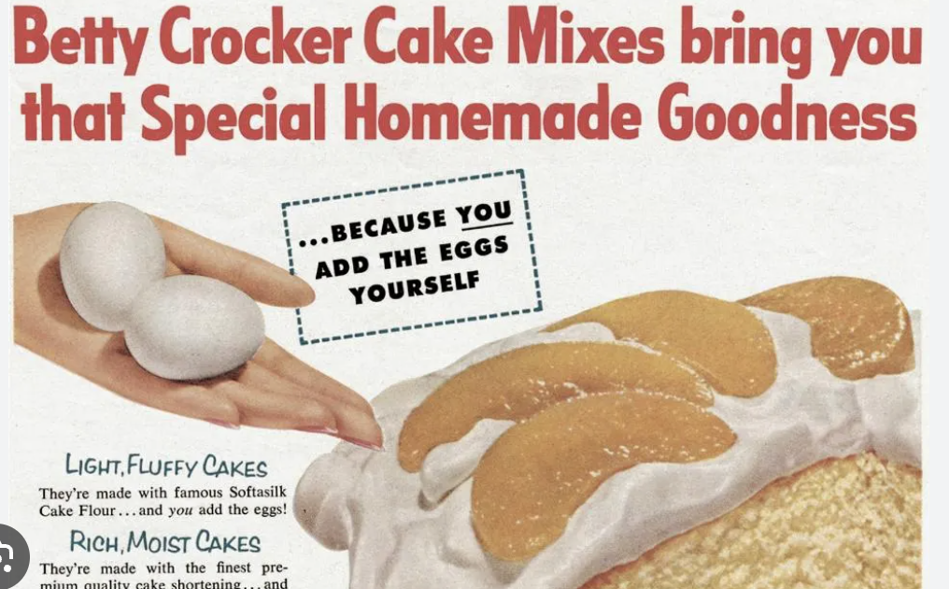
Emotion in baking a cake!
Notes:
https://www.psychologytoday.com/intl/blog/inside-the-box/201401/creativity-lesson-betty-crocker
1950, GM launched line of cake mixes under the famous brand. It included all the dry ingredients. All you needed was to add water and wallah…cake is ready.
However, it did not sell well.
GM bought on board a couple of psychologist to understand what went wrong! Why were Consumers resisting it? It saved so much time, still, it was not being adopted.
The short answer was guilt – The average American housewife felt bad using the product! Women felt guilty of getting more credit than they deserve. So they stopped using the product.

Slide 22

Lets have a look at this ad!
Notes:
Emotional Drivers of Consumer Behaviour
1. Desire for Belonging & Social Connection
Humans want to feel part of a group, community, or movement. Buying signals membership and acceptance.
Examples:
Harley Davidson clubs - owning a Harley is equal to belonging to a tribe.
Amul as “The Taste of India” collective national identity.
Instagram likes/follows i- digital belonging.
2. Aspiration & Status
Consumers buy to project who they want to be, signaling achievement, taste, or upward mobility.
Examples:
Apple iPhone - a badge of lifestyle.
Louis Vuitton bags - aspirational luxury.
3. Fear & Security
Fear of loss, uncertainty, or harm drives decisions toward safety and assurance.
Examples:
Dettol’s “100% protection” campaigns during COVID.
LIC’s insurance ads emphasizing family security.
Home security brands (ADT, Godrej Locks) appeal to fear of vulnerability.
4. Pleasure , Indulgence
The need for joy, fun, and sensory gratification often trumps logic. Consumers reward themselves.
Examples:
Cadbury Dairy Milk - “Kuch Meetha Ho Jaaye.”
Domino’s “30 minutes or free” - instant gratification.
Disneyland - “Happiest place on earth.”
5. Curiosity & Novelty
People seek stimulation and variety; trying something new excites them.
Examples:
Starbucks’ seasonal Pumpkin Spice Latte - novelty = anticipation.
Limited-edition sneaker drops - thrill of the new.
Netflix new show launches - curiosity-driven binging.
6. Control & Autonomy
Consumers want to feel in charge of choices, shaping identity and decisions.
Examples:
Subway’s “Make your own sub” - control over food.
Spotify’s personalized playlists - autonomy in music discovery.
7. Trust & Comfort
Familiarity and reassurance drive repeat buying. Consumers stay loyal when they feel safe and cared for.
Examples:
Colgate - generations of trust.
Maggi - “2-Minute Noodles” comfort food.
Airbnb’s “Belong Anywhere” builds trust in strangers’ homes.
8. Identity & Self-Expression
Purchases reflect “who I am” or “who I want the world to see me as.”
Examples:
Nike’s “Just Do It” -identity of ambition and grit.
FabIndia - rooted, ethnic, yet modern identity.
Patagonia - eco-conscious lifestyle signal.
9. Achievement & Mastery
People buy to feel capable, successful, or to mark progress in life.
Examples:
Duolingo gamifies learning - achievement badges.
Gym memberships / Strava app - tracking mastery.
10. Nostalgia & Roots
Consumers often reach for brands that remind them of childhood, tradition, or heritage.
Examples:
Amul - Indian family nostalgia.
Old Monk rum → generational loyalty and memory.

Slide 23
Emotional Drivers of Consumer Behaviour
1. Desire for Belonging & Social Connection
Humans want to feel part of a group, community, or movement. Buying signals membership and acceptance.
Examples:
  Harley Davidson clubs - owning a Harley is equal to belonging to a tribe.
  Amul as “The Taste of India” collective national identity.
  Instagram likes/follows i- digital belonging.
2. Aspiration & Status
Consumers buy to project who they want to be, signaling achievement, taste, or upward mobility.
Examples:
  Apple iPhone - a badge of lifestyle.
  Louis Vuitton bags - aspirational luxury.
3. Fear & Security
Fear of loss, uncertainty, or harm drives decisions toward safety and assurance.
Examples:
  Dettol’s “100% protection” campaigns during COVID.
  LIC’s insurance ads emphasizing family security.
  Home security brands (ADT, Godrej Locks) appeal to fear of vulnerability.
4. Pleasure , Indulgence
The need for joy, fun, and sensory gratification often trumps logic. Consumers reward themselves.
Examples:
  Cadbury Dairy Milk - “Kuch Meetha Ho Jaaye.”
  Domino’s “30 minutes or free” - instant gratification.
  Disneyland - “Happiest place on earth.”
5. Curiosity & Novelty
People seek stimulation and variety; trying something new excites them.
Examples:
  Starbucks’ seasonal Pumpkin Spice Latte - novelty = anticipation.
  Limited-edition sneaker drops - thrill of the new.
  Netflix new show launches - curiosity-driven binging.
6

Slide 24
. Control & Autonomy
Consumers want to feel in charge of choices, shaping identity and decisions.
Examples:
  Subway’s “Make your own sub” - control over food.
  Spotify’s personalized playlists - autonomy in music discovery.
7. Trust & Comfort
Familiarity and reassurance drive repeat buying. Consumers stay loyal when they feel safe and cared for.
Examples:
  Colgate - generations of trust.
  Maggi - “2-Minute Noodles” comfort food.
  Airbnb’s “Belong Anywhere” builds trust in strangers’ homes.
8. Identity & Self-Expression
Purchases reflect “who I am” or “who I want the world to see me as.”
Examples:
  Nike’s “Just Do It” -identity of ambition and grit.
  FabIndia - rooted, ethnic, yet modern identity.
  Patagonia - eco-conscious lifestyle signal.
9. Achievement & Mastery
People buy to feel capable, successful, or to mark progress in life.
Examples:
  Duolingo gamifies learning - achievement badges.
  Gym memberships / Strava app - tracking mastery.
10. Nostalgia & Roots
Consumers often reach for brands that remind them of childhood, tradition, or heritage.
Examples:
  Amul - Indian family nostalgia.
  Old Monk rum → generational loyalty and memory.

Slide 25
Consumers don’t just rely on Logic, but take shortcuts
Notes:
Our brains are meaning-making machines. We don’t just consume products. We consume stories. Symbols. Signals.

Slide 26
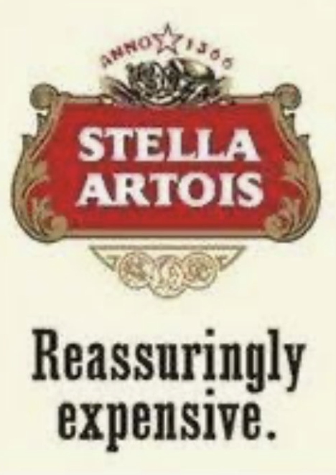

Can someone explain this ad
Notes:
"Stella Artois Reassuringly Expensive" was a highly successful advertising slogan used by the brand in the United Kingdom from 1982 to 2007, which reframed the beer's higher price as a mark of premium quality and sophistication, transforming a perceived negative into a positive and turning the brand into a market leader. The campaign is known for its distinctive European-style cinema commercials, particularly the "mini-epics" from the 1990s, which featured borrowed music from the score of the French film Jean de Florette.

Slide 27
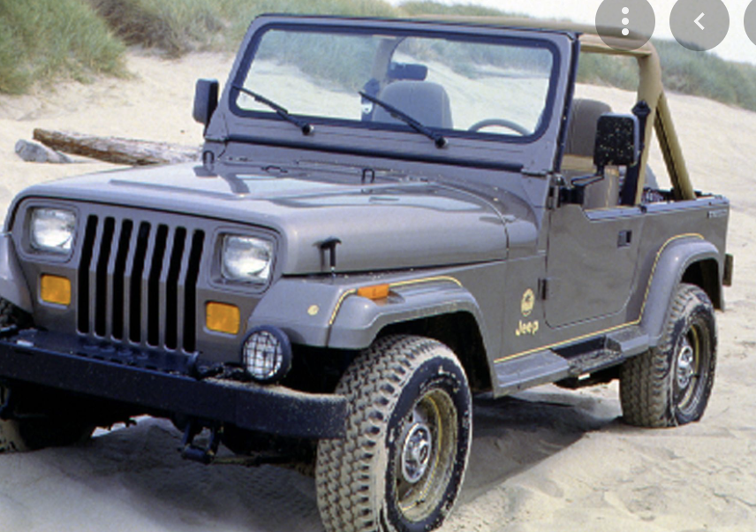
Story of a Horse!
A category of its own!
Launched in 1986
90’s - Challenged by SUVs, Sales decline!
Chrysler, owner of the Wrangler, was ready for an overhaul
Wanted to reposition it to challenge to SUVs
Consumer Research – Checked with what people wanted
Direction – More luxury, Enclosed!
Jeep Wrangler
Notes:
Useful links - https://www.parkerklein.com/notes/the-culture-code
Recommended book – Culture Code by Clotaire Rapille
Notes for Slide
Jeep wrangler is a very popular car in the US. Was unique, like the thar in India
In the late 1990’s, the popularity was waning, leading the sales decline. This was on the back on launch of many new variants of SUVs
Chrysler, the owner of the the wrangler, was all set to overhaul the the wrangler and after a lot of research, they were set to reposition the same to be a SUV. They wanted to evaluate the route of luxury, moved to a vehicle that was enclosed
They bought on board Clotaire Rapaille. He had a unique way to research, where he did not ask what they want, but dug deep to find out earliest memories of Jeep!
His research expertise is on culture coding, which is the unconscious meaning we apply to any given thing, via the culture we are raised. Clotaire is expert on how to influence people through unconscious decision making
Codes are imprints left in an individual, through emotion and learning. You can tell a child the pan is hot, but by experiencing the pain on touching a hot pain, will increase the child's learning and leave an imprint.

Slide 28
Useful links - https://www.parkerklein.com/notes/the-culture-code
Recommended book – Culture Code by Clotaire Rapille
Notes for Slide
Jeep wrangler is a very popular car in the US. Was unique, like the thar in India
In the late 1990’s, the popularity was waning, leading the sales decline. This was on the back on launch of many new variants of SUVs
Chrysler, the owner of the the wrangler, was all set to overhaul the the wrangler and after a lot of research, they were set to reposition the same to be a SUV. They wanted to evaluate the route of luxury, moved to a vehicle that was enclosed
They bought on board Clotaire Rapaille. He had a unique way to research, where he did not ask what they want, but dug deep to find out earliest memories of Jeep!
His research expertise is on culture coding, which is the unconscious meaning we apply to any given thing, via the culture we are raised. Clotaire is expert on how to influence people through unconscious decision making
Codes are imprints left in an individual, through emotion and learning. You can tell a child the pan is hot, but by experiencing the pain on touching a hot pain, will increase the child's learning and leave an imprint.

Slide 29



Story of a Horse!
Clotaire Rapaille – “I did not ask what they want, but dug deep to find out earliest memories of Jeep”
Culture Coding– Unconscious meaning we apply to any given thing-via the culture we are raised!
STORIES
Open Land – American West
Rugged Terrain
Ride Free
Notes:
Difference in Culture makes us process information in a different way

Slide 30
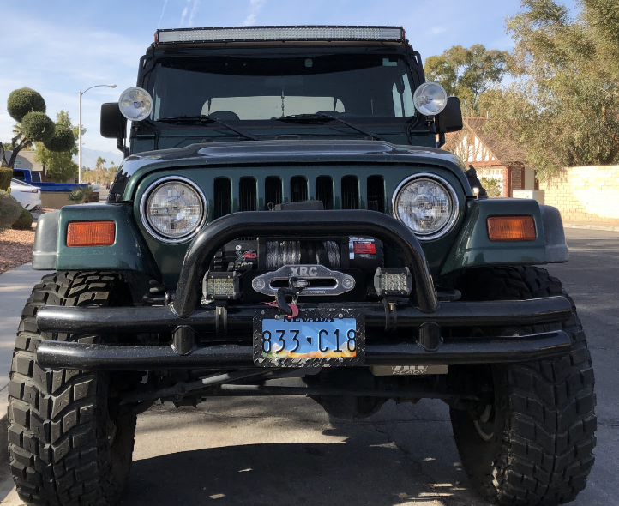
Culture Code – HORSE
The direction of overhauling this to luxury will be a mistake
Horses don’t have luxury appointments, butter soft leather!
He got them to make one small change!
Response was positive
Sales increased the round headlights and grille are regular feature ever-since
They made it part of its logo!
Advertising!

Slide 31
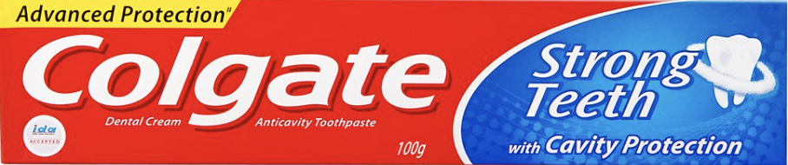
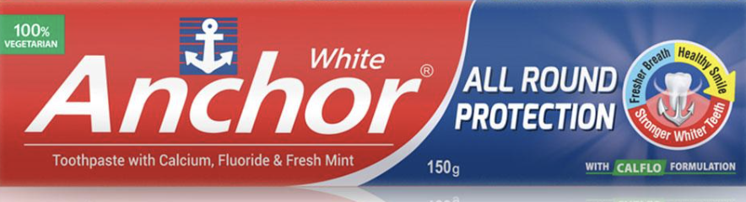
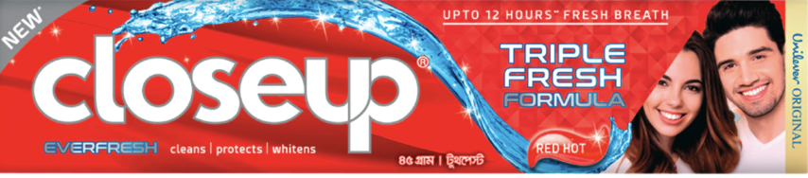
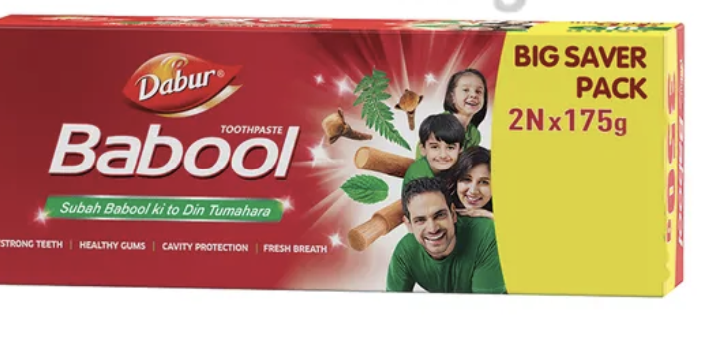
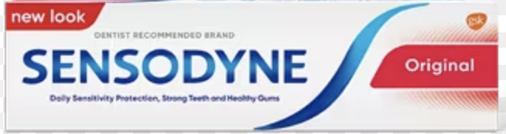
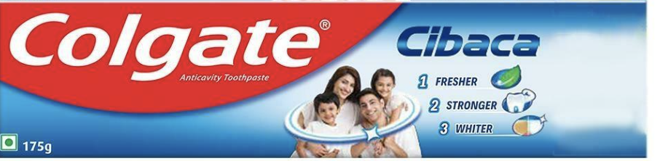

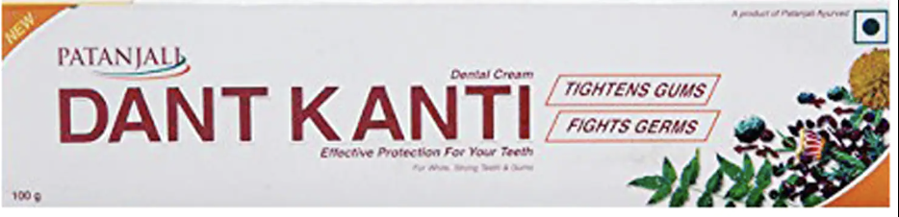
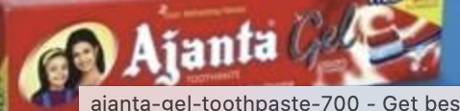
Not Just About Price

Slide 32
Segmenting Toothpaste Basis Visuals
Notes:
How Symbols Impact Consumer Decision-Making
Symbols Create Shortcut Meanings
Consumers don’t process every product rationally — symbols act as mental shortcuts that carry cultural or emotional meaning.
Example
The party symbol in election campaigns -instant identity and recall, beyond policy.
The Nike swoosh - performance, speed, achievement, without needing explanation.
The cork on a bottle – Signifies sophistication, taste, purity and very high quality
Similarly some brands have created symbols that drive behaviour or emotions
Example: The McDonald’s Golden Arches — wherever you are in the world, it signals consistency and familiarity.
Symbols Trigger Emotions & Memories
Symbols carry emotional weight that can unlock nostalgia, belonging, or comfort.
Example - Maggi’s yellow packaging - nostalgia and childhood comfort for multiple generations.
Example - The Coca-Cola contour bottle - happiness and heritage.
Why Symbols Matter in Decision-Making
They reduce cognitive load (we don’t think deeply; we respond to symbols).
They carry cultural codes (shared meaning within a society).
They influence status, belonging, and trust — the emotional triggers that drive buying.

Slide 33
How Symbols Impact Consumer Decision-Making
Symbols Create Shortcut Meanings
Consumers don’t process every product rationally — symbols act as mental shortcuts that carry cultural or emotional meaning.
Example
The party symbol in election campaigns -instant identity and recall, beyond policy.
The Nike swoosh - performance, speed, achievement, without needing explanation.
The cork on a bottle – Signifies sophistication, taste, purity and very high quality
Similarly some brands have created symbols that drive behaviour or emotions
Example: The McDonald’s Golden Arches — wherever you are in the world, it signals consistency and familiarity.
Symbols Trigger Emotions & Memories
Symbols carry emotional weight that can unlock nostalgia, belonging, or comfort.
Example - Maggi’s yellow packaging - nostalgia and childhood comfort for multiple generations.
Example - The Coca-Cola contour bottle - happiness and heritage.
Why Symbols Matter in Decision-Making
They reduce cognitive load (we don’t think deeply; we respond to symbols).
They carry cultural codes (shared meaning within a society).
They influence status, belonging, and trust — the emotional triggers that drive buying.

Slide 34
Psychology list many Shortcuts/Heuristics
Confirmation Bias
  tendency to listen more often to information that confirms our existing beliefs
Hindsight Bias
  tendency to see events, even random ones, as more predictable than they are - the "I knew it" phenomenon
Anchoring Bias
  tendency to be overly influenced by the first piece of information that we hear
Misinformation Bias
  tendency for memories to be heavily influenced by things that happened after the actual event itself
Actor-Observer Bias
  tendency to attribute our actions to external influences and other people's actions to internal ones
False Consensus Effect
  tendency people have to overestimate how much other people agree with their own beliefs, behaviors, attitudes, and values
Halo Effect
  tendency for an initial impression of a person to positively influence what we think of them overall
Horn Effect
  tendency for an initial impression of a person to negatively influence what we think of them overall
Self-Serving Bias
  tendency for people tend to give themselves credit for successes but lay the blame for failures on outside causes
Availability Bias
  tendency to estimate the probability of something happening based on how many examples readily come to mind
Affinity Bias
  tendency to form a deeper connection with someone you share a connection with or share a perceived connection with
Selection Bias
  tendency to notice things more when something has happened to make us notice that particular thing more
163 more…
Notes:
Useful Links - https://www.nineblaess.de/blog/25-cognitive-biases/
Consumer Bias Concepts
1. Value & Price Perception Biases
Anchoring Bias – First price/number seen sets the reference point (e.g., “Was ₹1999, now ₹999”).
Decoy Effect – Presence of a third “decoy” option nudges consumers to pick the more profitable choice.
Price-Quality Heuristic – Higher price is assumed to signal higher quality (e.g., luxury goods, Stella Artois).
Zero Price Effect – People overvalue free items (e.g., “Buy one, get one free”).
2. Loss & Risk Biases
Loss Aversion – Losses hurt more than equivalent gains please (why “limited-time offers” work).
Endowment Effect – People value things more once they own them (free trials, “Add to cart” nudges).
Sunk Cost Fallacy – Continuing with something just because you already invested (unused gym memberships).
Certainty Effect – Overvaluing guaranteed outcomes over probabilistic ones (insurance, warranties).
3. Choice & Decision Biases
Choice Overload – Too many options create paralysis (why curated menus sell more).
Paradox of Choice – Fewer options can actually increase satisfaction.
Framing Effect – Decisions change depending on wording (90% fat-free vs. 10% fat).
Default Effect – People stick to the pre-set option (auto-subscriptions, organ donation).
4. Social & Identity Biases
Social Proof – People copy others (ratings, reviews, “bestseller” tags).
Bandwagon Effect – Popularity fuels more popularity.
Authority Bias – Expert or celebrity endorsement sways decisions.
In-group Bias – Preference for brands that signal belonging to one’s tribe/identity.
Scarcity Bias – Limited editions or stock-outs increase desirability.
5. Time & Emotion Biases
Hyperbolic Discounting – Preferring smaller-sooner rewards over larger-later (credit cards, instant delivery).
Present Bias – Valuing immediate gratification over long-term benefit (junk food vs. diet).
IKEA Effect – Overvaluing things you’ve built yourself (customisation, DIY kits).
Affect Heuristic – Emotions dominate rational evaluation (fear ads, happy jingles).
6. Memory & Attention Biases
Availability Heuristic – Decisions driven by how easily examples come to mind (news-driven fear).
Recency Effect – Most recent exposure has greater impact.
Peak-End Rule – People remember experiences by peak + end, not the average (restaurants, events).
Mere Exposure Effect – Repeated exposure increases liking (why ads work without logic).
7. Effort & Effort-Reward Biases
Effort Justification – We value rewards more if we’ve worked harder for them (loyalty programs).
Commitment & Consistency Bias – Once we commit, we want to appear consistent (subscriptions, “foot-in-the-door” sales).
Overconfidence Effect – Believing we make rational, unique choices (while following herd cues).

Slide 35
Exercise 5 – You are opening a GYM in your locality
And you are trying to get memberships from the residents of the society.
Task - Now
Go through all the listed concepts of Bias
Identify 2 most important bias concepts you can leverage. Articulate how you will use them
Later - To upload for all to see
Use CANVA to create an Ad using any one of the Bias concepts
E.G – Anchoring bias – Membership 1999, now 999/-
Notes:
https://www.nineblaess.de/blog/25-cognitive-biases/

Slide 36
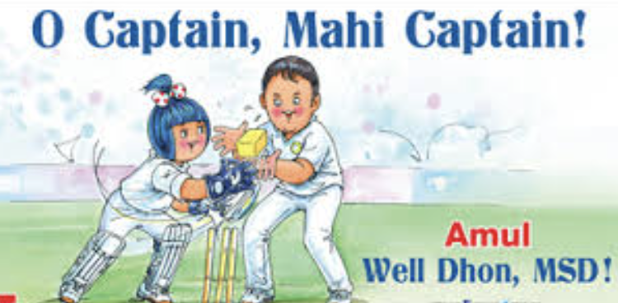
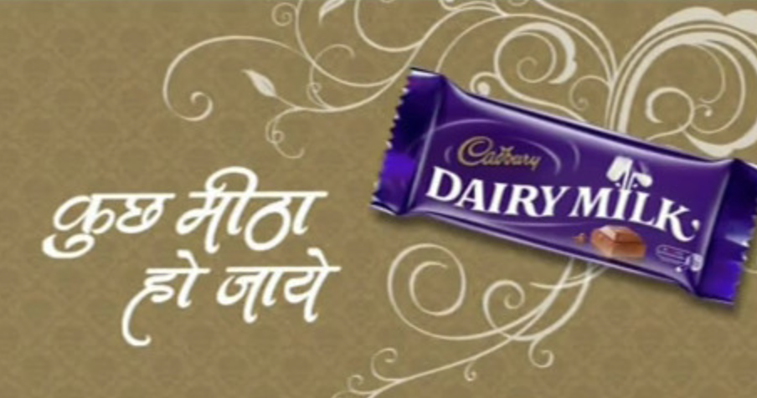
Lets look at examples that heuristics used at each stage
Sharing
Sharing
Reflecting & Repurchasing
Reflecting & Repurchasing
Using
Using
Availability heuristic - driving Top of Mind Recall
Availability heuristic - driving Top of Mind Recall
Choosing & Coordinating
Choosing & Coordinating
Learning
Learning
Witnessing
Witnessing
Arriving & Browsing
Arriving & Browsing
Researching
Inspired
Witnessing
Wanting/Problem Recognition
Framing – Driving Cadbury as a sweet that you can distribute during celebration
Notes:
Notes
1. Wanting / Problem Recognition
The buying journey begins when a consumer feels a gap between their current state and what they desire. This isn’t always about necessity — it’s often about aspiration, self-expression, or lifestyle. Brands create this spark by highlighting problems or showing possibilities.
Examples:
Availability Heuristics – Top-of-mind examples feel like the most relevant solutions.
1. Amul - Amul’s topical ads keep it always present in consumers’ minds (exposure). Availability through distribution in stores also keeps it top of mind in the consumers mind.
2. CRED – Driving awareness and trying to build a problem.
Framing - How the problem is presented shapes the want.
Cadbury trying to reposition chocolates as sweets
FOGG trying to repositioning for long Lasting trying to create and own a problem statement.
Lenskart reframing from a medical solution to accessory
Havells-

Slide 37
Notes
1. Wanting / Problem Recognition
The buying journey begins when a consumer feels a gap between their current state and what they desire. This isn’t always about necessity — it’s often about aspiration, self-expression, or lifestyle. Brands create this spark by highlighting problems or showing possibilities.
Examples:
Availability Heuristics – Top-of-mind examples feel like the most relevant solutions.
1. Amul - Amul’s topical ads keep it always present in consumers’ minds (exposure). Availability through distribution in stores also keeps it top of mind in the consumers mind.
2. CRED – Driving awareness and trying to build a problem.
Framing - How the problem is presented shapes the want.
Cadbury trying to reposition chocolates as sweets
FOGG trying to repositioning for long Lasting trying to create and own a problem statement.
Lenskart reframing from a medical solution to accessory
Havells-

Slide 38



Slide 39
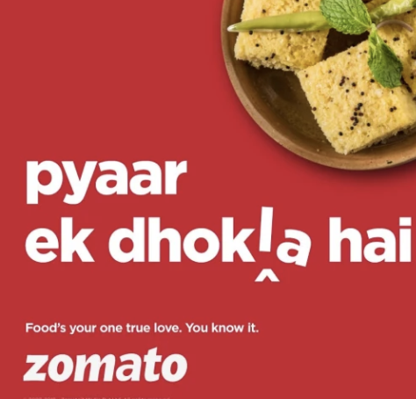
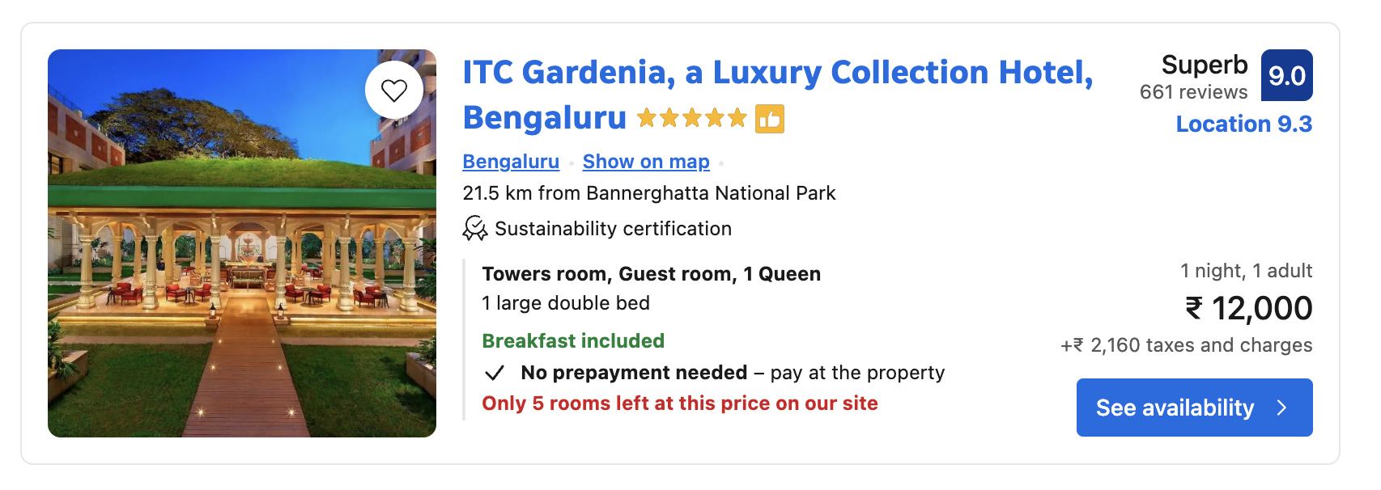

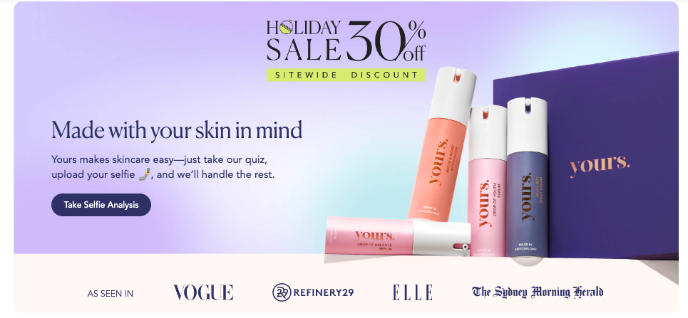
Lets look at examples that heuristics used at each stage
Sharing
Reflecting & Repurchasing
Evaluation & Purchase
Using
Availability heuristic - driving Top of Mind Recall
Choosing & Coordinating
Learning
Information Search
Witnessing
Arriving & Browsing
Scarcity bias
Researching
Inspired
Authority Bias
Witnessing
Authority Bias

Slide 40
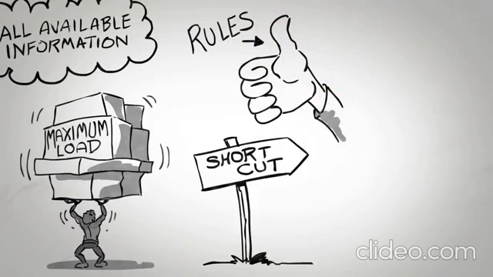
Notes:
Reciprocity
People feel obligated to return a favor.
Examples: Free samples in supermarkets, Sephora’s free mini-kits, Zomato giving free delivery coupons → you feel nudged to “give back” by purchasing.
Commitment & Consistency
Once people commit (even in small ways), they want to stay consistent with that commitment.
Examples: Signing a small pledge to recycle → more likely to do it; “Add to wishlist” nudges on e-commerce; free trial subscriptions leading to paid continuity.
Social Proof
People copy what others are doing, especially in uncertainty.
Examples: Amazon “Bestseller” tags, Zomato’s “most ordered dish”, “9 out of 10 dentists recommend Colgate.”
Authority
We follow credible, knowledgeable experts or authority figures.
Examples: Doctor endorsements in pharma ads; celebrity chefs endorsing kitchenware; verified badges on Instagram giving authority to influencers.
Liking
We say yes more easily to people/brands we like or feel connected to.
Examples: Influencer marketing (because we like/trust them); Dove’s “Real Beauty” campaign; charismatic salespeople.
Scarcity
People want more of what they perceive as rare or in limited supply.
Examples: “Only 2 left in stock” on Amazon, limited-edition sneakers, Flipkart Big Billion Day countdown timers.

Slide 41
Reciprocity
  People feel obligated to return a favor.
  Examples: Free samples in supermarkets, Sephora’s free mini-kits, Zomato giving free delivery coupons → you feel nudged to “give back” by purchasing.
Commitment & Consistency
  Once people commit (even in small ways), they want to stay consistent with that commitment.
  Examples: Signing a small pledge to recycle → more likely to do it; “Add to wishlist” nudges on e-commerce; free trial subscriptions leading to paid continuity.
Social Proof
  People copy what others are doing, especially in uncertainty.
  Examples: Amazon “Bestseller” tags, Zomato’s “most ordered dish”, “9 out of 10 dentists recommend Colgate.”
Authority
  We follow credible, knowledgeable experts or authority figures.
  Examples: Doctor endorsements in pharma ads; celebrity chefs endorsing kitchenware; verified badges on Instagram giving authority to influencers.
Liking
  We say yes more easily to people/brands we like or feel connected to.
  Examples: Influencer marketing (because we like/trust them); Dove’s “Real Beauty” campaign; charismatic salespeople.
Scarcity
  People want more of what they perceive as rare or in limited supply.
  Examples: “Only 2 left in stock” on Amazon, limited-edition sneakers, Flipkart Big Billion Day countdown timers.

